Slide 1
Retail Analytics – Chips Category Review
June 2026
Prepared for: Julia
Prepared by: Mahibur Mahi
Brand note: If client logo is not required, use alternate title page layout right click slide thumbnail > Layout > Title

Slide 2
Executive summary
01
Task 1 - Customer and Product Insights
Mainstream customers generated the highest total sales ($750,744.50).
Older Singles/Couples were the highest revenue-generating life-stage segment ($404,226.75).
Kettle was the top-performing chip brand, generating approximately $390K in sales. 175g packs were the most popular pack size, contributing nearly $485K in sales.
Young Singles/Couples (Mainstream) recorded the highest average spend per transaction.
02
Task 2 - Trial Store Performance
Trial Store 77 outperformed Control Store 233 during the trial period. Trial Store 86 generated higher sales than Control Store 155, particularly during March 2019.
Trial Store 88 showed the strongest performance improvement compared with Control Store 237.
All three trial stores achieved higher sales than their respective control stores during the trial period.
Results suggest that the new store layout had a positive impact on customer purchasing behaviour and sales performance.

Slide 3
Category Performance Overview
Older Singles/Couples generated the highest sales ($404,226.75).
Young Families and Retirees also contributed significantly.
New Families represented the smallest segment.

Slide 4
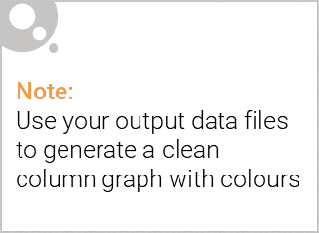
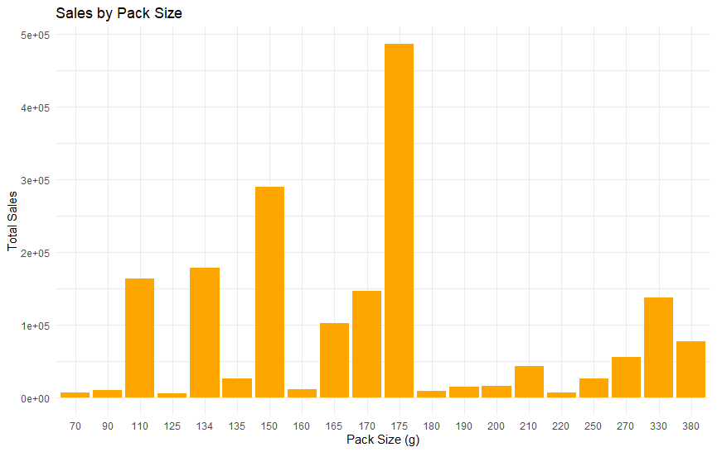
Affluence & Customer Behaviour
Mainstream customers generated the highest sales ($750,744.50).
Budget customers were the second-largest contributor.
Premium customers generated the lowest overall sales.

Slide 5
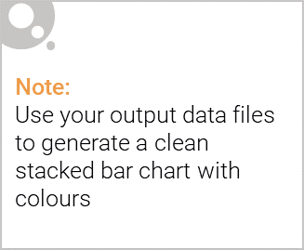
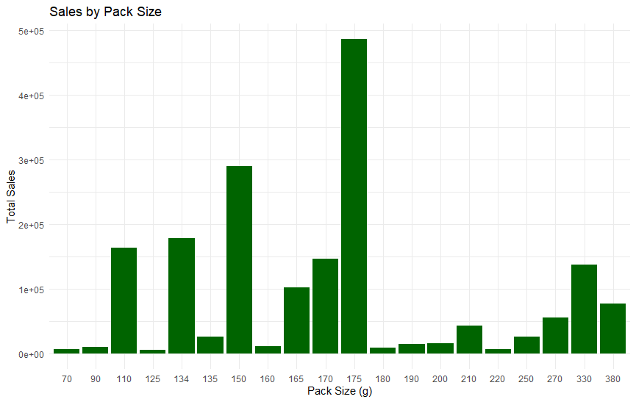
Editable (delete this)
Product Preferences
Kettle was the leading chip brand.
Smiths and Doritos were also strong performers.
175g packs were the most popular pack size.

Slide 6

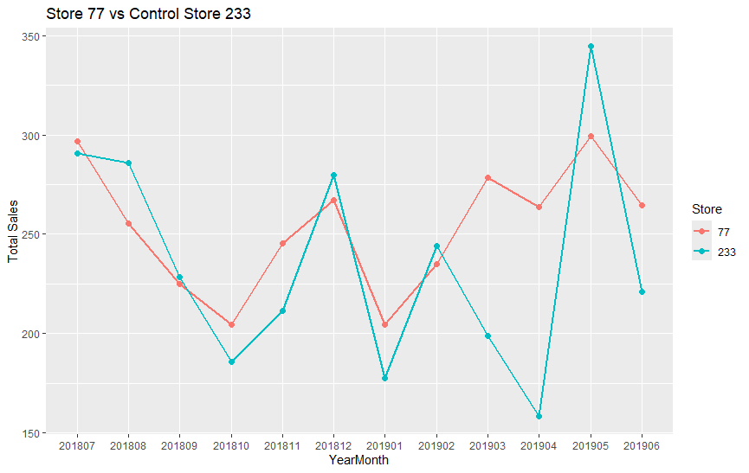
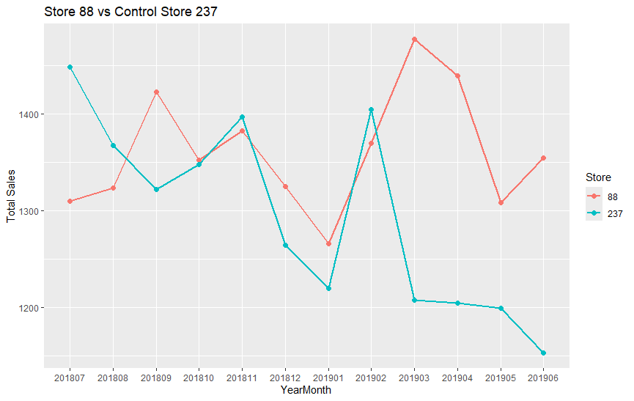
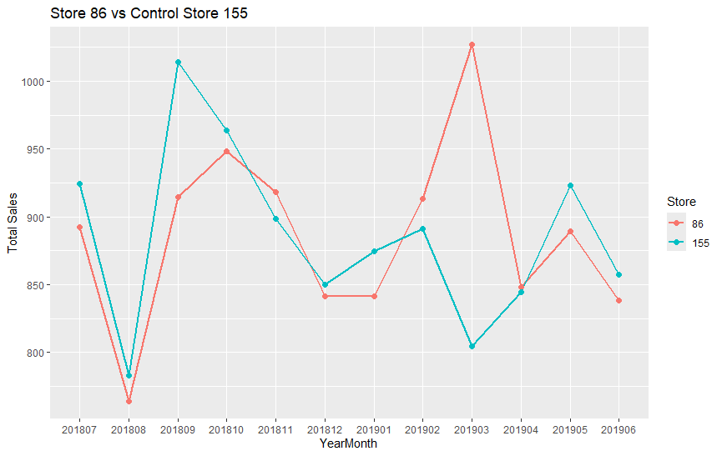
Store 77 vs 233: Successful
Store 86 vs 155: Successful
Store 88 vs 237: Most Successful

Slide 7
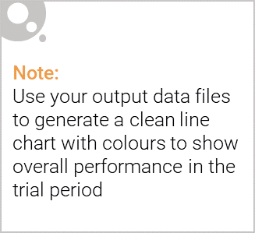
Recommendations & Conclusion
Focus on Mainstream customers.
Prioritise Older Singles/Couples and Young Singles/Couples.
Maintain inventory of Kettle products and 175g packs.
Consider rolling out the trial layout to additional stores.

